Slide 1
GROUP 1
VISUAL RECOGNITION

Slide 2
VISUAL RECOGNITION IN AI
Visual recognition is an evolving field in AI that focuses on enabling machines to see and understand the visual world similarly to humans.
It relies on deep learning algorithms particularly CNN’s.
These algorithms are trained on massive datasets of labeled images and videos, allowing them to extract features and patterns from visual data.

Slide 3
ALGORITHMS USED
Convolutional Neutral Network (CNN)
Random Forest
Support Vector Machines (SVM)
K Nearest Neighbor (KNN)

Slide 4
WHAT IS CNN?
CNN stands for convolutional neural network. It is a deep learning algorithm that is widely used for analyzing visual data, such as images and videos. CNNs are highly effective in tasks such as image classification, object detection, facial recognition, and image segmentation.

Slide 5
WHY CNN?
Convolutional neural networks, are used for their ability to automatically extract relevant features from visual data, such as images. They're really good at finding patterns in pictures, like edges or colors, and they can recognize objects no matter where they are in the picture. They learn to understand pictures by looking at different layers of details, starting with simple things like lines and shapes, and then putting those details together to understand more complex objects.

Slide 6
HOW CNN WORKS
They work by breaking down the image into smaller parts and looking for patterns in those parts. The network learns to recognize different features like edges or textures. It then combines these features to understand more complex shapes or objects. CNNs use layers to process the image and make predictions about what it contains. The key components of a CNN include convolutional layers, pooling layers, and fully connected layers. They are trained by comparing their predictions to the correct answers and adjusting their internal settings to improve accuracy. This allows them to learn how to recognize and classify objects in images.

Slide 7
IMAGE CLASSIFICATION
Image classification is the task of categorizing or labeling images into different predefined classes or categories.
The goal is to develop and train a model that can automatically analyze the features of an image and assign it to one of several predefined classes.

Slide 8
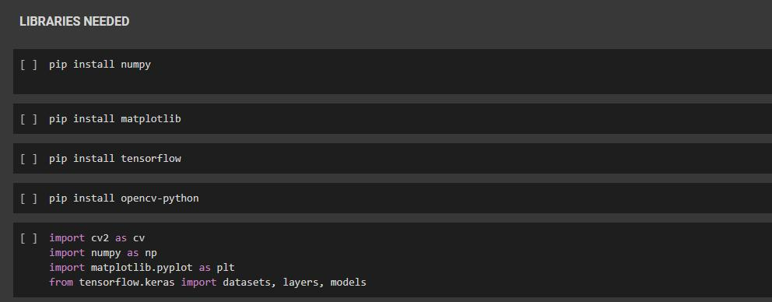
Notes:
NUMPY: Python library used for numerical computations. Provides tools for working with large, multidimensional arrays.
MATPLOTLIB: Library for creating visualizations and plots, provides tools for creating different types of graphs, charts and plots
TensorFlow: provides tools for building a neural network
OPENCV: library for computer vision and image processing tasks. Provides tools that helps one work with images and perform operations such as image manipulation and object detection
TENSORFLOW.KERAS provides access to many datasets for ML (DATASETS)
TENSORFLOW.KERAS provides a collection of predefined layers (LAYERS)
TENSORFLOW.KERAS provides API for building and training models (MODELS)

Slide 9
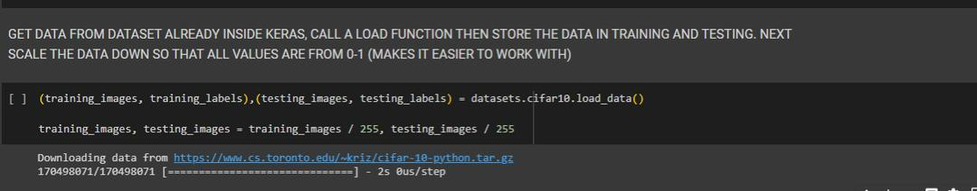
Notes:
The pixel value of the images is normalized by dividing them by 255, this scales down the pixels original value from a range of 0-255 to a range of 0-1. This helps to stabilize the learning process during model training.

Slide 10
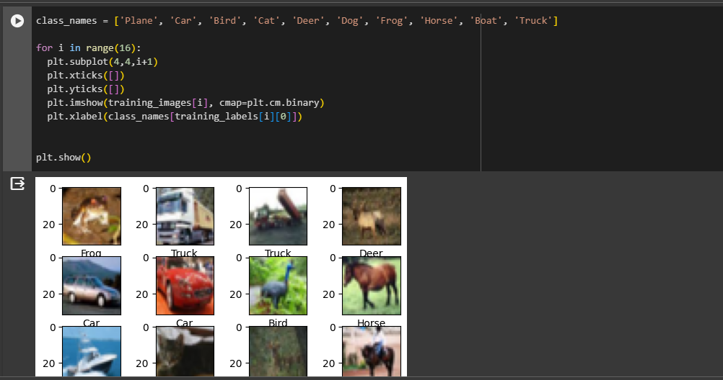
The provided code snippet visualizes a set of training images with their respective class labels. It defines a list of class names representing different objects. The code then uses a loop to create a 4x4 grid of subplots. Within each subplot, an image from the training set is displayed using a binary color map

Slide 11
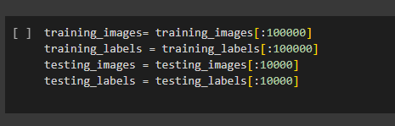
Instead of training the neural network on the whole data, we are picking the first 100,000 training examples and the first 10,000 testing examples. Working with a smaller subset of the original dataset enables quicker experimentation or prototyping.

Slide 12
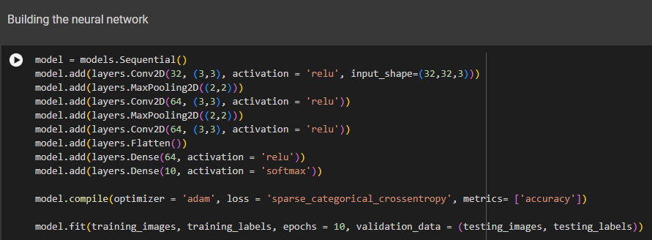
Conv2D is an important operation used in convolutional neural networks (CNNs) to find patterns in images. It works by sliding small filters across the image and multiplying the filter values with the corresponding image pixels.
Notes:
A sequential model is created by using models.Sequential(). The model is built by adding layers one after the other using the add method.
First layer is the conv2D layer used to perform convolutional operations on the input data. First has 32 filters with size 3x3

Slide 13
ReLU, short for Rectified Linear Unit, is a popular activation function used in neural networks, particularly in deep learning models. It is a simple mathematical function that returns the input value if it is positive, and zero if the input value is negative.
Notes:
Maxpooling is down-sampling the feature map and extracting important information from the input data.
Max pooling works by sliding a small window (often 2x2 or 3x3) across the feature map. At each position, the maximum value within the window is selected and kept, while the other values are discarded. This helps to reduce computational requirements.
The Flatten layer is used to flatten the 2D feature map into a 1D vector
A dense layer is a big group of neurons that each takes inputs from all the neurons in the previous layer. Each neuron multiplies the inputs by some numbers (weights), and then applies an activation function to the result. This helps the network learn patterns in the data.
Adam optimizer is a popular optimizer used for optimization algorithm
Sparse categorical cross entropy: the goal is to reduce the mismatch between predicted probabilities and true labels
Accuracy is used to evaluate the performance of the model
Model.fit is called to train the model

Slide 14
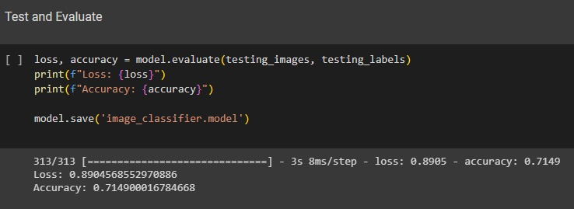
Evaluation is done on the model based on the testing dataset. It takes the images and their corresponding labels as input.
Notes:
Model.save Is used to save the trained model to the file named “image_classifier.model” which allows you reuse the model later without having to train it from scratch

Slide 15
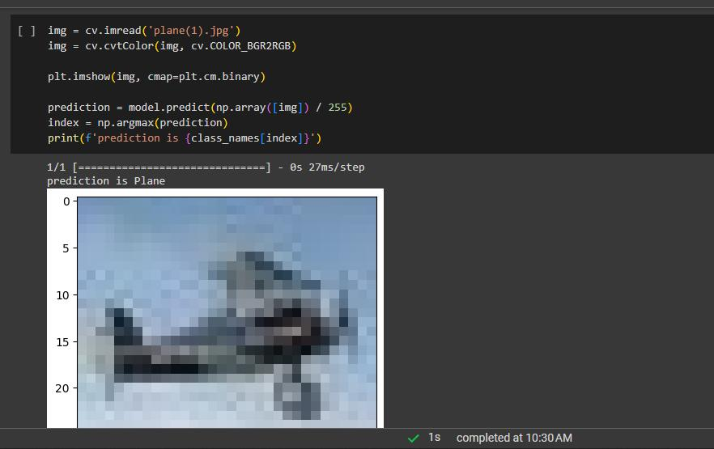
cv.imread is a function in the OpenCV library used to read an image and store it in the variable “img”.
Converting an image from BGR to RGB is important for compatibility, accurate display, and proper interpretation of colors in the image because most deep-learning models use the RGB format.
Notes:
Im.read used to read the image with file name plane.jpg and store it in the variable img
Cv,cvtcolor(img, cv.COLOR_BGR2RGB) is a function used to convert image from BGR TO RGB because most deep learning models use RGB format
Plt.imshow is used to display the image
plt.cm.binary refers to a binary colormap. A binary colormap is a colormap that consists of two colors, typically black and white. you are instructing Matplotlib to use a binary colormap for the plot, which will map the data values to shades of black and white.
It takes the image as input, processes it, and makes a prediction. The prediction is a list of probabilities for each possible class. The code finds the index of the highest probability in the prediction list, which represents the predicted class. It then prints the predicted class name based on the index.

Slide 16
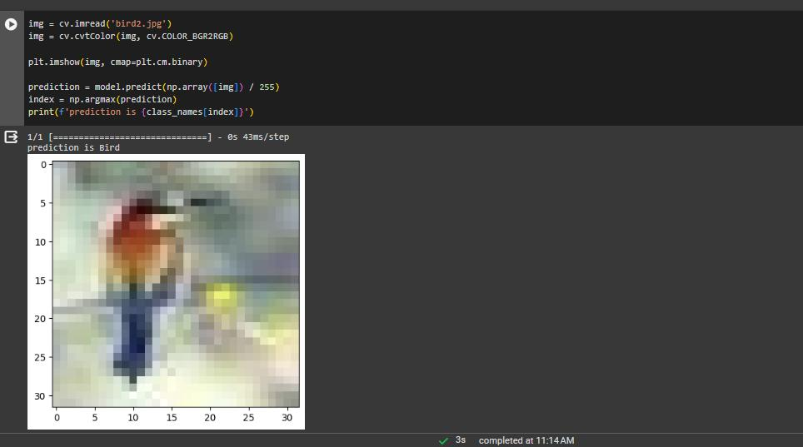

Slide 17
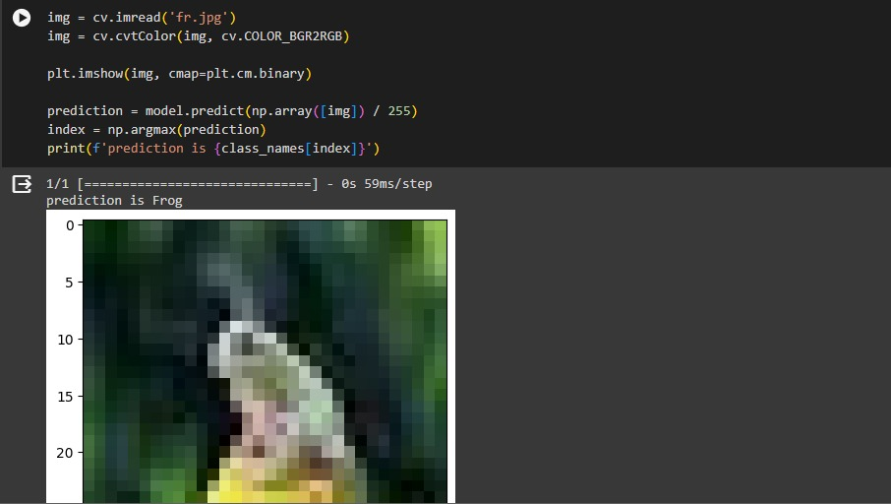

Slide 18
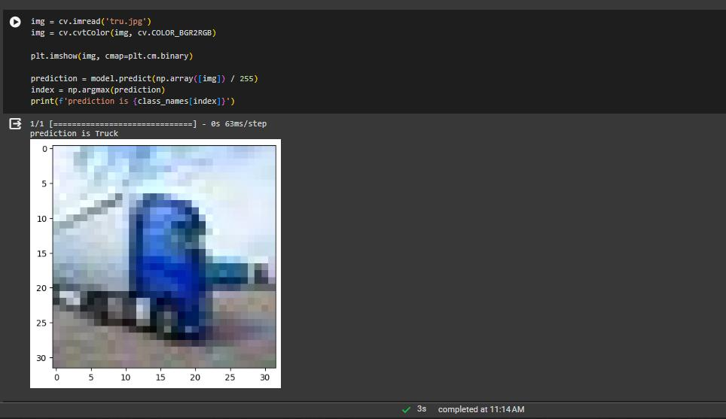

Slide 19
RANDOM FOREST ALGORITHM
A random forest is an ensemble learning method, primarily used for classification and regression. It works by constructing multiple decision trees during training and outputting the class that is the mode of the classes (classification) or mean prediction (regression) of the individual trees.

Slide 20
WHY RANDOM FOREST IN VISUAL RECOGNITION?
Random forests are utilized for their robustness against overfitting, as they average out biases by combining the results of various trees. In the context of visual recognition, they are effective because they can handle high-dimensional data and identify the most informative features from a large dataset, such as pixels in images.

Slide 21
HOW DOES RANDOM FOREST WORK?
For visual recognition, random forest first trains on subsets of the image dataset with a random selection of features at each tree node, creating a "forest" of decision trees. During the recognition phase, each tree votes for a class, and the highest voted class is chosen. The model's ensemble approach enhances accuracy, as it reduces the risk of errors from individual trees.

Slide 22
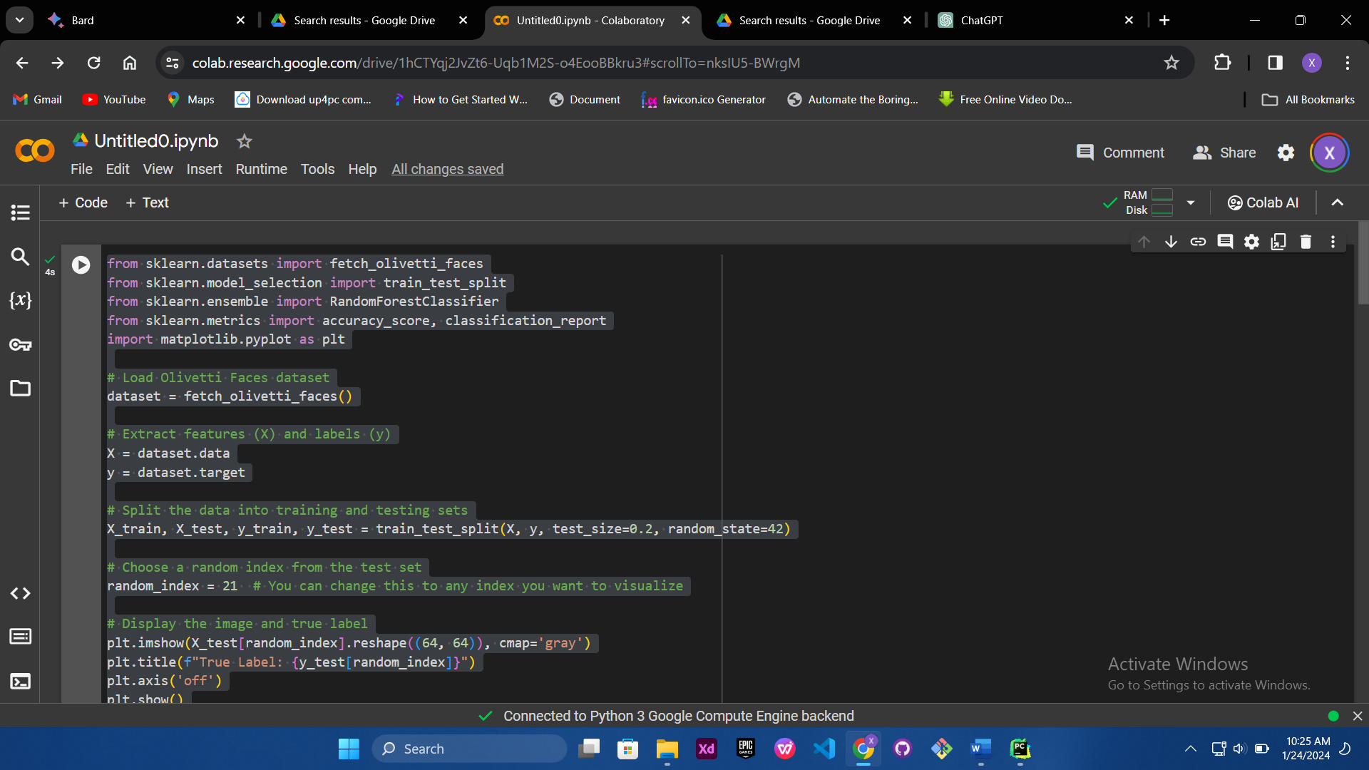

Slide 23
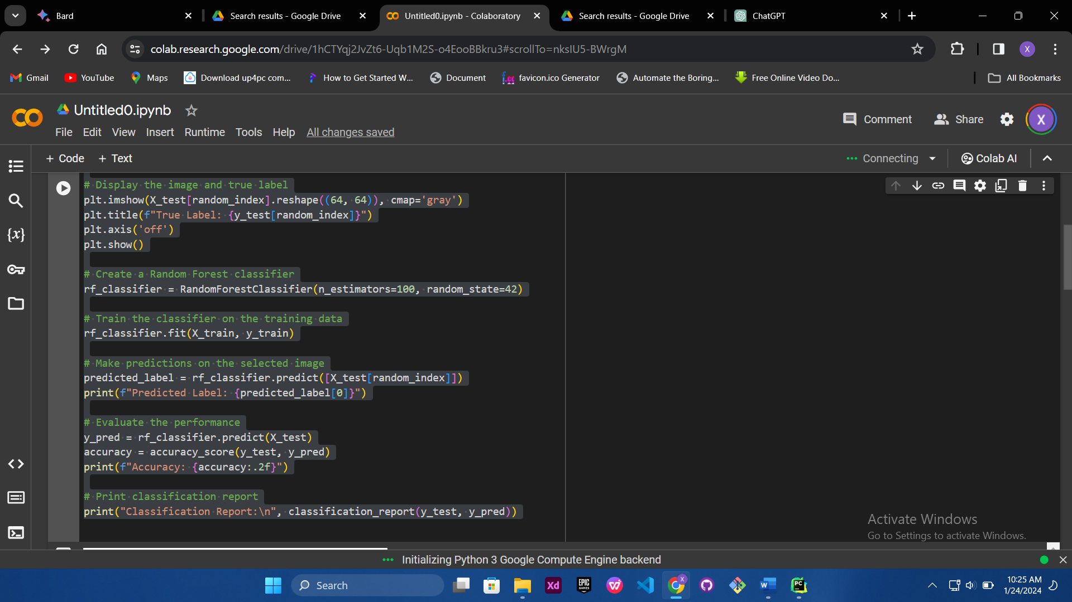

Slide 24
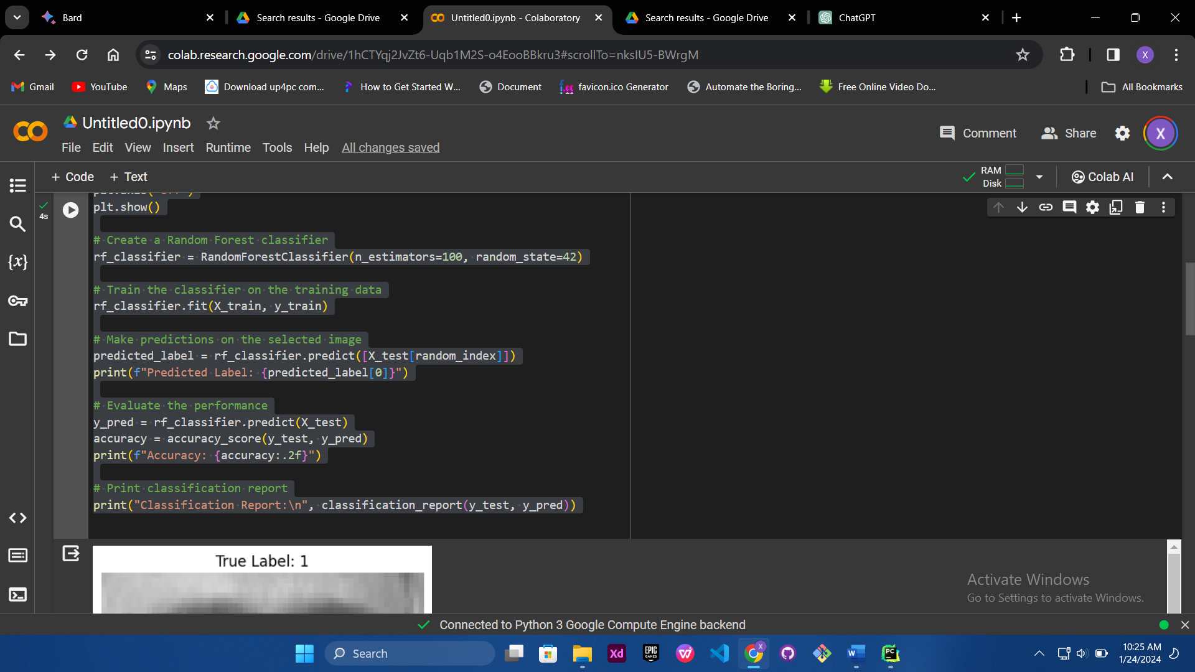

Slide 25
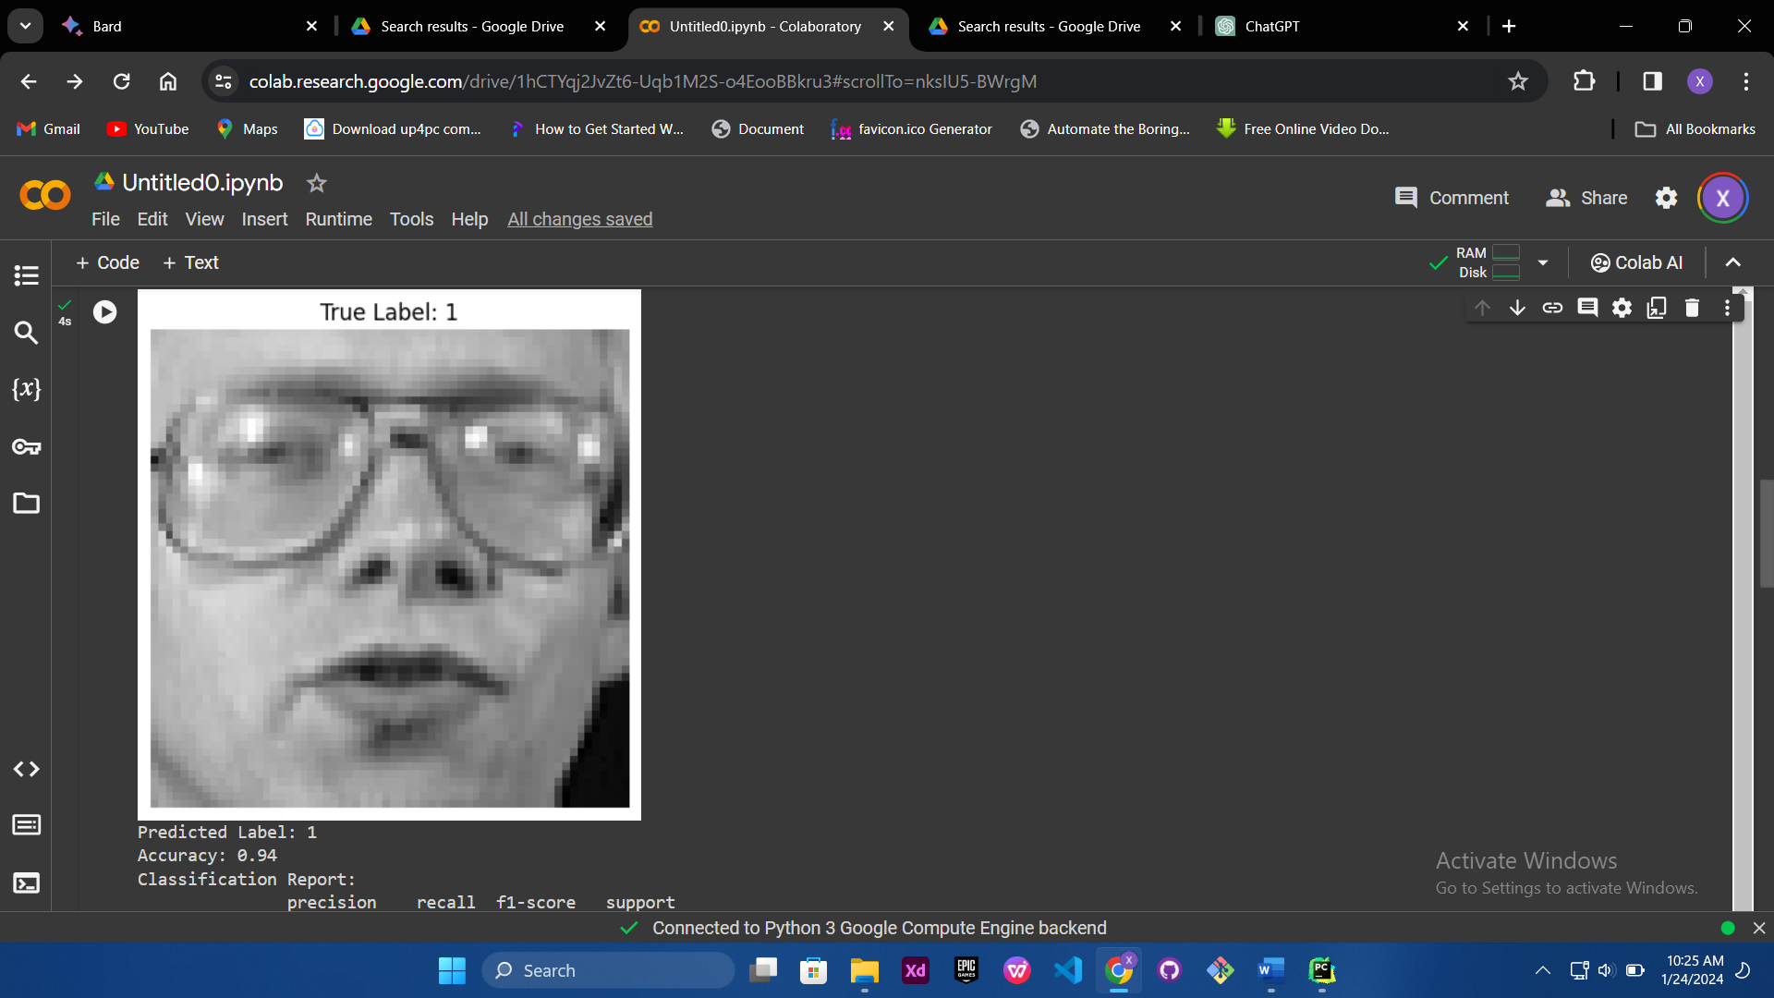

Slide 26
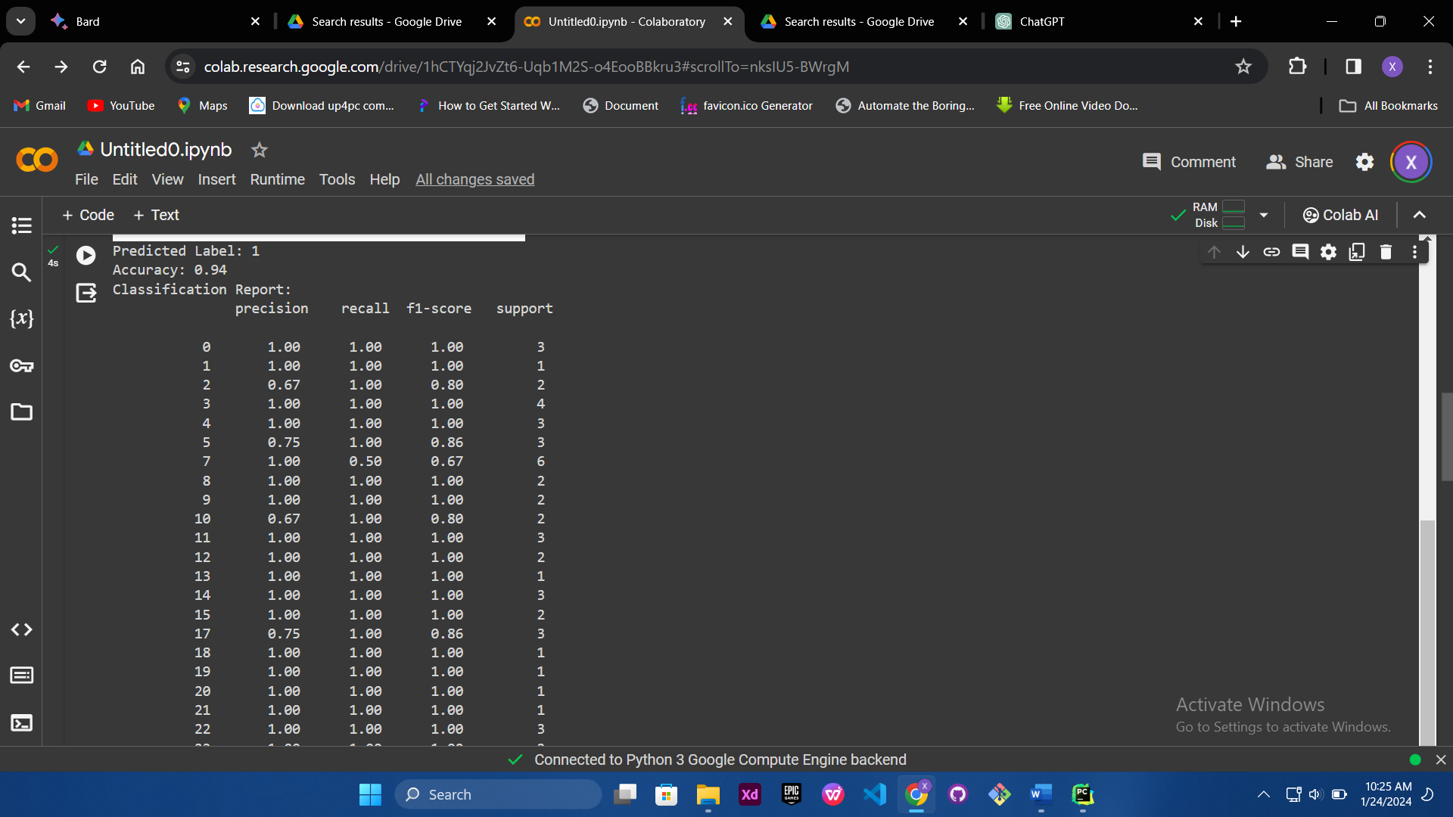

Slide 27
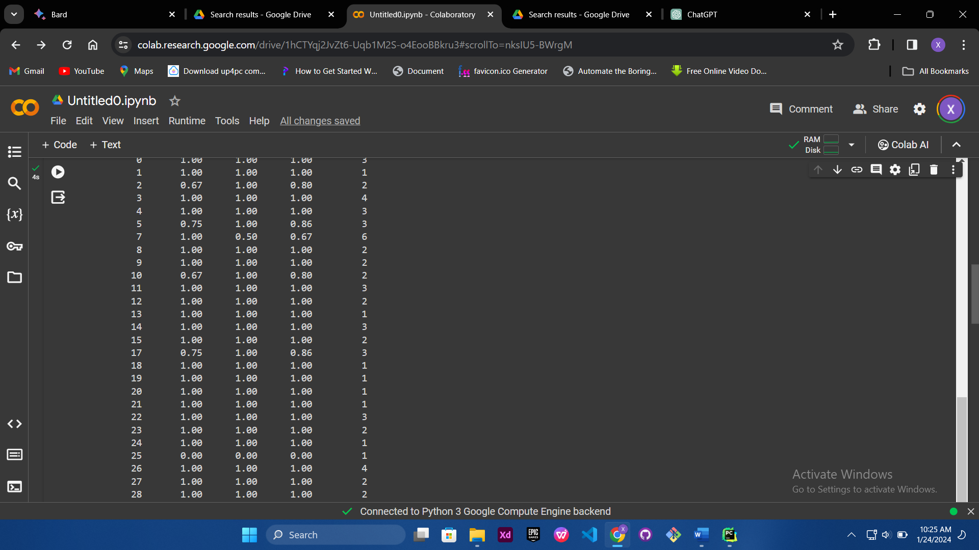

Slide 28
VISUAL RECOGNITION SPECIFICS
In visual tasks, trees in the random forest decide on pixel values, colors, textures, or other image features. The random selection of features at each node is crucial because it forces the model to explore diverse feature combinations, enhancing the forest's capability to generalize from visual patterns.

Slide 29
SUPPORT VECTOR MACHINE ALGORITHM
Introduction to support vector machine in visual recognition: In machine learning, Support Vector Machine stands out as a powerful tool, particularly when it comes to tasks like image classification. Support vector machine learns to draw boundaries between different classes in a dataset. It finds the best way to draw a hyperplane ensuring the most accurate classification.

Slide 30
WHY SVM IN VISUAL RECOGNITION?
Effective in high dimensions: Images are often represented as high-dimensional data, with each pixel acting as a dimension. SVM excels in such scenarios, making it a perfect fit for visual data.
Versatility: SVM proves to be versatile. Its ability to handle complex datasets makes it indispensable in various applications.
Optimal Decision Boundaries: SVM finds the optimal decision boundaries, leading to precise and accurate classifications.

Slide 31
To demonstrate the capabilities of a support vector machine using an image classification model here's how the model works:

Slide 32
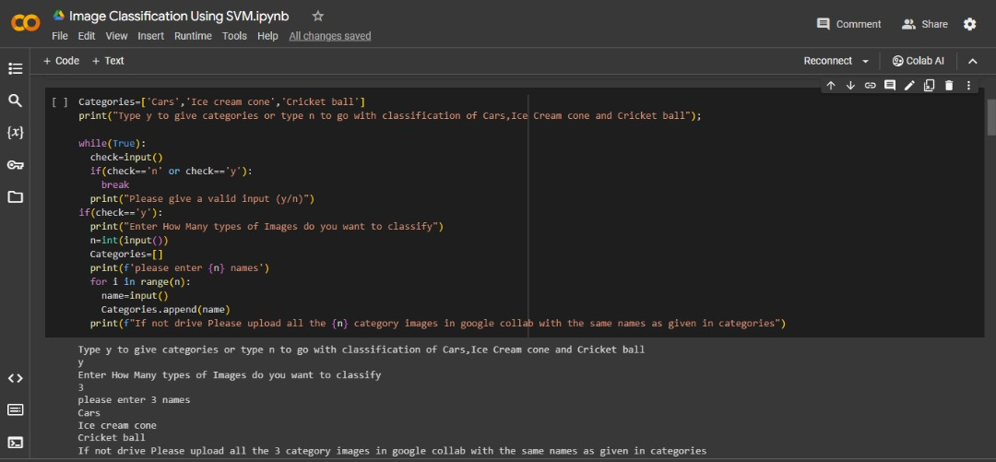
CATEGORY SELECTION

Slide 33
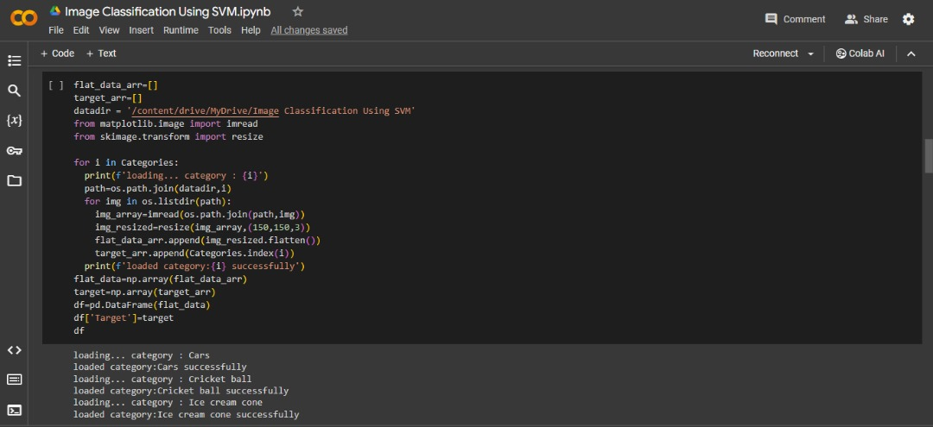
GIVE PATH OF THE FOLDER CONTAINING ALL CATEGORY IMAGES AND LOAD THE DATA.

Slide 34
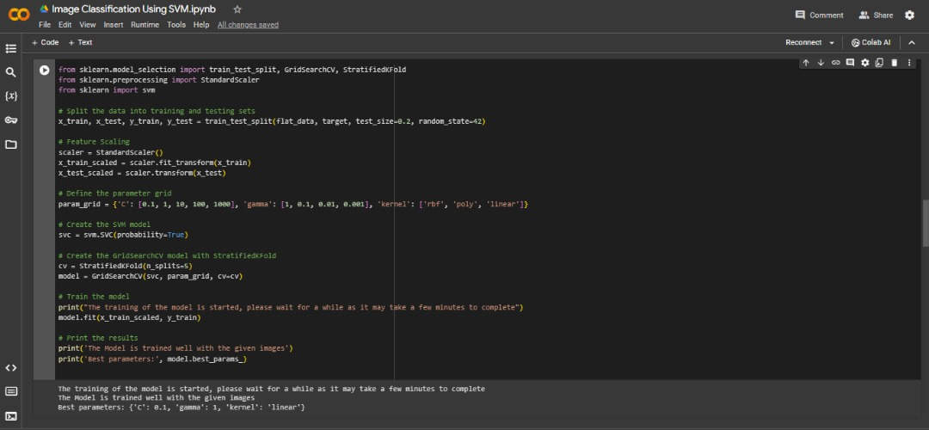
TRAINING THE DATA USING SUPPORT VECTOR CLASSIFICATION MODEL

Slide 35
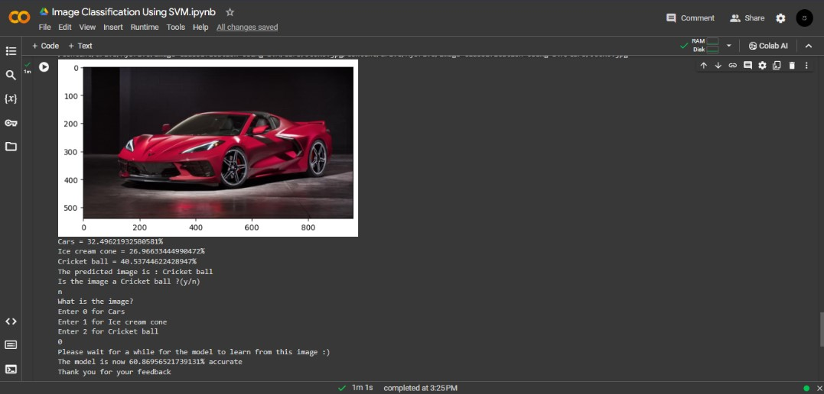
TESTING THE MODEL

Slide 36
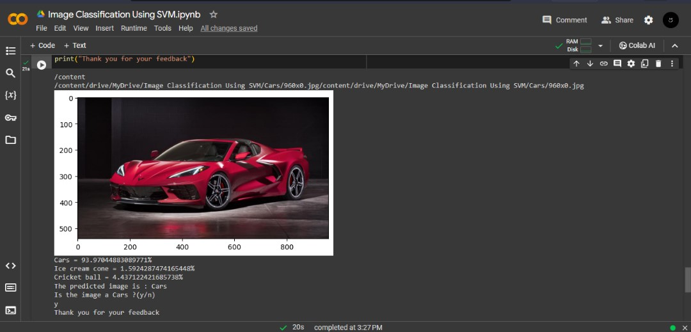
TESTING THE MODEL 2

Slide 37
K NEAREST NEIGHBOUR
What Is KNN algorithm: the k-nearest neighbors algorithm, also known as KNN or k-nn, is a non-parametric, supervised learning classifier, which uses proximity to make classifications or predictions about the grouping of an individual data point. While it can be used for either regression or classification problems, it is typically used as a classification algorithm, working off the assumption that similar points can be found near one another.

Slide 38
HOW KNN ALGORITHM CAN BE USED IN VISUAL RECOGNITION
K-nearest neighbours (KNN) is one of the popular algorithms used in face recognition. It's a supervised learning approach that is used for classification purposes. It operates by locating the nearest neighbours of a data point and classifying it according to the majority of its neighbours.

Slide 39
WHY KNN IS USED
The KNN algorithm can compete with the most accurate models because it makes highly accurate predictions. Therefore, you can use the KNN algorithm for applications that require high accuracy but that do not require a human-readable model.

Slide 40
CHALLENGES OF USING KNN
KNN has some drawbacks and challenges, such as computational expense, slow speed, memory and storage distance metric, and susceptibility to the curve of dimensionality.

Slide 41
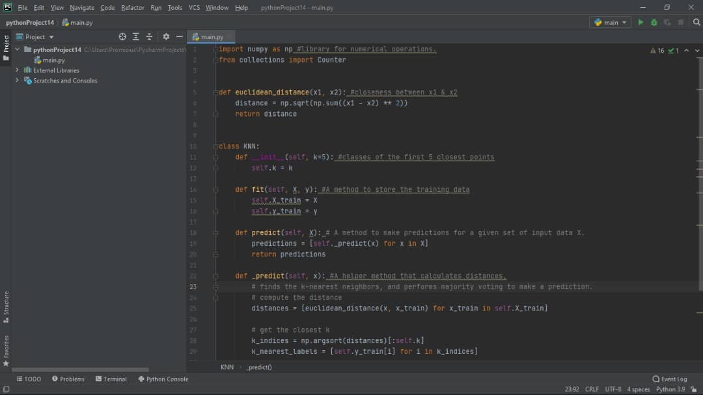

Slide 42
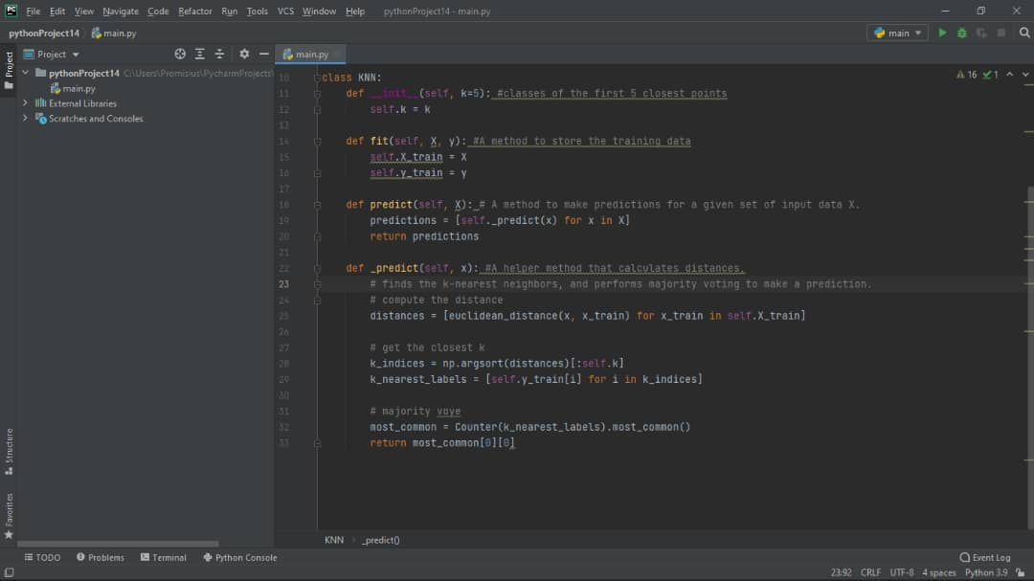

Slide 43
